Slide 1
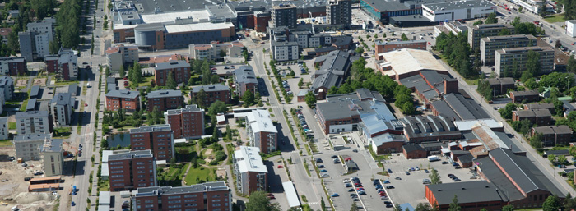
School transport organised by the City of Hyvinkää for pre-primary and basic education pupils
The Basic Education Act lays down conditions under which the city organises school transport for preschool and basic education pupils. This is a summary of the organisation and the rules of school transport. The full version of the basic education school transport guide is available at Hyvinkaa.fi/koulukuljetukset.
Parents/Guardians are always primarily responsible for teaching their children how to operate safely in traffic.
Using public transport and school buses
Matters to be noted
The school’s ordinances are also valid during school commute.
Traffic safety is always the priority during school transport. Moving from one place to another inside the vehicle during transport is not allowed and seat belts must be kept fastened at all times.
Pupils may only bring with them on school transport sports equipment or other extra items that are needed according to their timetable, for example at gym glass, or the transport of which has been separately agreed upon between the school and the transporter.
Pupils must be at the agreed stop on time and give the driver a clear stop signal by raising their hand. During the winter season, reflectors add to your child’s visibility!
Driving conditions may affect transport schedules. Transport is not considered to be late if it arrives at the stop within 10 minutes of the agreed time.
The transport vehicle may not pass the stop before the agreed time, unless all the pupils boarding from that stop are already on the bus.
If you move house, you must submit a new transport application for your child.
If your child loses their bus card, you can purchase a new one at a Matkahuolto or Hyvinkään Liikenne service point. Further information is available from your school secretary if necessary.
We ask that all changes to pupils’ timetables be communicated in advance.
The parent/guardian must notify the transporter or school transport service if their child is ill or does not need school transport for some other reason.
Additional information
E-mail: koulukuljetukset@hyvinkaa.fi
Wilma message to Koulukuljetukset (school transport)
Telephone 040 155 6420

